Slide 1







Travolla

Slide 2
I Problem Definition

Slide 3


Planning activities
Navigating an unfamiliar location
Language barriers
Stressful Travelling
Elderly
Disabled
Ignored Demographics

Slide 4
II Solution Overview

Slide 5



Heat Map
3
Main
Services
Optimised Journey Planner
Local to Tourist Matching Service

Slide 6


Web
2
Release
Platforms
Mobile (Android)

Slide 7
Dalian China
2 International Locations
Brisbane Australia
Multi-User Account System
Iteration 1
Security of user information
Information of company and product

Slide 8
III Environmental Requirements

Slide 9






Software
Brackets: Writing source code
GitHub: Code storage & collaboration
GitKraken: Git Client
Chrome: Viewing code
Bootstrap: Open-source toolkit for web framework
Illustrator: Graphic Design

Slide 10



Hardware
Server: Deploying and hosting backend
WiFi: Internet access point
Laptop: Development
Android Device: Test Android app

Slide 11
IV Risk Analysis

Slide 12

Risk Analysis
Risk
Severity
Response
Version Control Discrepancies
Medium
Use GitHub to enforce version control.
Competitors
Medium
Implement unique features at a faster rate.
New Team
Low
Spend time getting to know team’s strengths and weaknesses.
Language Barrier
Low
Slow and clear communication over a variety of mediums.
New Environment
Medium
Research facilities and attempt to fix issues.
New Technology
Medium
Research and confer with knowledgeable team members.
Time Constraint
High
Ensure a high level of organization, create realistic goals.
Component Linking
Low
Ensure clear communication during development.

Slide 13
V Team

Slide 14






Léa
UI / UX
Ed
Backend
Henry
Frontend
Ada
Backend
Jason
Frontend
Erik
Frontend

Slide 15
VI Core Functionality

Slide 16
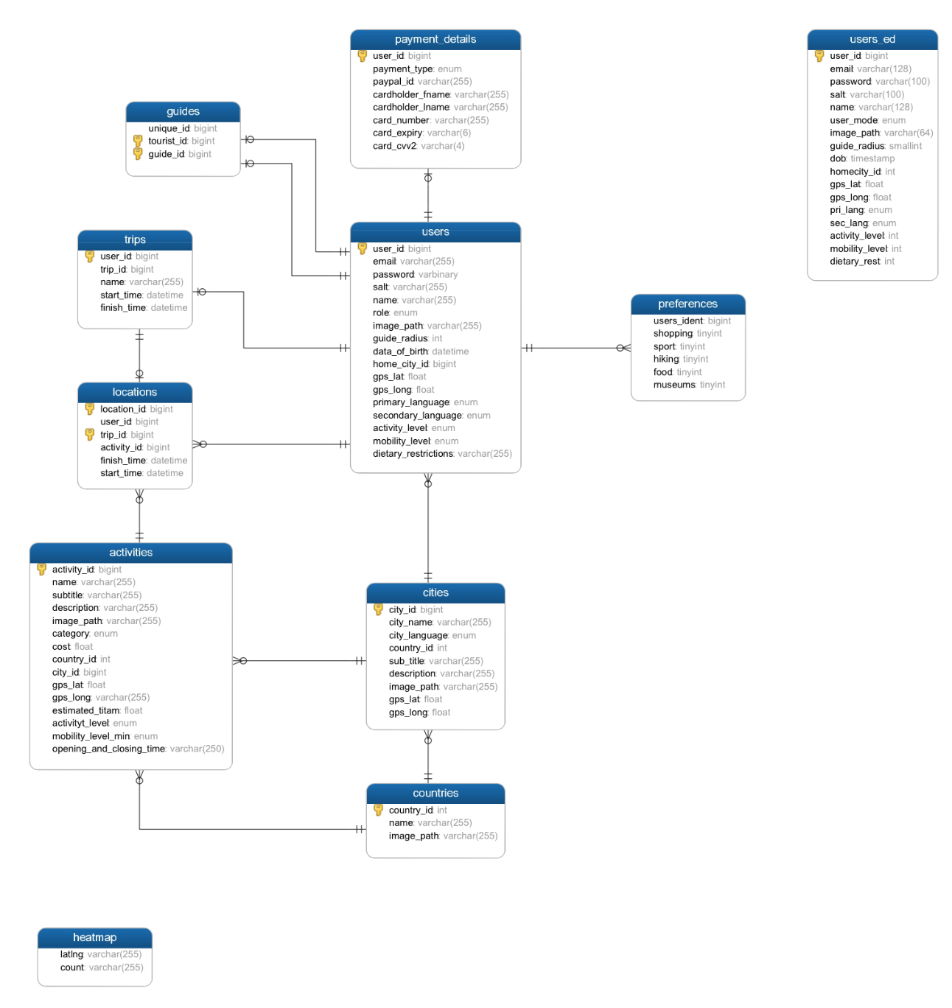
Database ER Diagram

Slide 17

HeatMap
Takes statistics on activity popularity and displays them in an interactive, visual way.
Used to make decisions about activities for optimised timetables
Make instantaneous decisions based on live information

Slide 18

Optimised Journey Planner (OJP)
Produces an optimised timetable of activities around you based on:
Personal interests
Popularity of attractions
Best times to visit
Accessibility requirements
Level of activity

Slide 19
Local to Tourist Matching Service
Match tourists with local people at their destination, incorporating factors such as:
Location of Local and Tourist
Current time
First and second language of Local
Personal interests of Local and Tourist
Activity level of Local and Tourist
Accessibility status of Local and Tourist

Slide 20
VII Retrospective

Slide 21
Problem
Linking Journey Planner to Database – Choosing between NodeJS and AJAX for SQL integration.
Pressing buttons too quickly produced unexpected results due to slow internet
JavaScript is a new language for many of us – Problems with multiple functions executing simultaneously rather than sequentially like in other languages
Solution
Chose AJAX as it integrated more smoothly with the pre-existing PHP.
No feasible solution to slow internet yet
Limiting number of functions used to force sequential flow.

Slide 22
Keep
Clearly assigned roles
Setting manageable goals
Problem
Merge conflicts
Slow access to development servers
Unfamiliarity with languages and technologies being used
Try
Breaking down roles further
Using subgoals to more specifically assign work
Clear communication is key. Found that messaging a group chat when working on a document (so that only one person is working on a document at any time) was efficient for a small group
Creating new servers
Working as a team to teach each other and share skills

Slide 23
VIII Iteration

Slide 24









Iteration 1
Iteration 2
Functional Guide Matching
Improvements of three key features
Functional Journey Planner
Add more cities and destinations
Functional Heat Map

